Slide 1
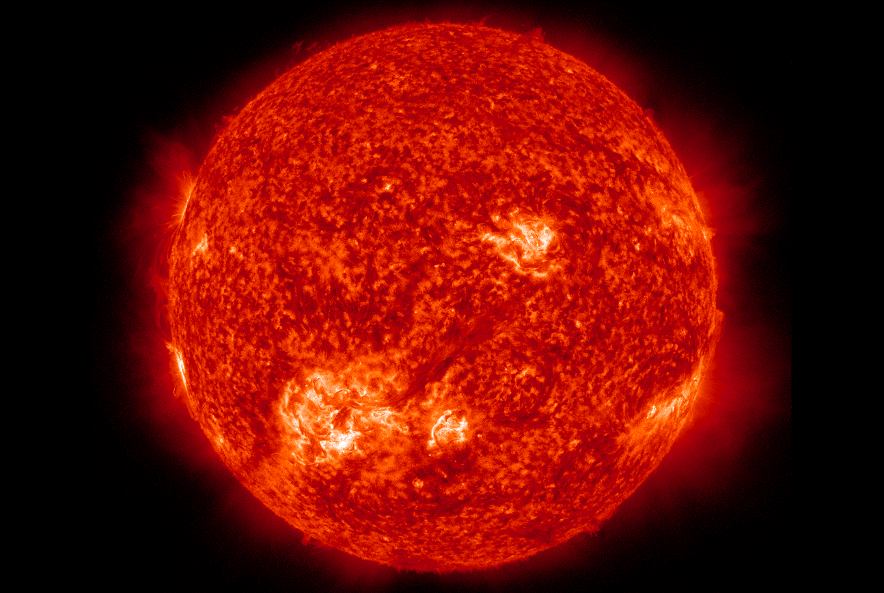
Stellar Evolution Simulator
Reese Danzer and Karthik Boyareddygari

Slide 2

Overview
Our project is a visualization of the structure, contents, and characteristics of a star as a function of time.
Users input a desired starting mass for the star and the portion of the star’s life they want to view.
Our program takes that input and pulls data for the specified mass from a database we built, interpolates that data to get continuous functions, and uses those functions to populate the visualization in various ways.
Users are then given a slider with which they determine the point in the star’s life being viewed, and the visual dynamically updates with the slider.

Slide 3
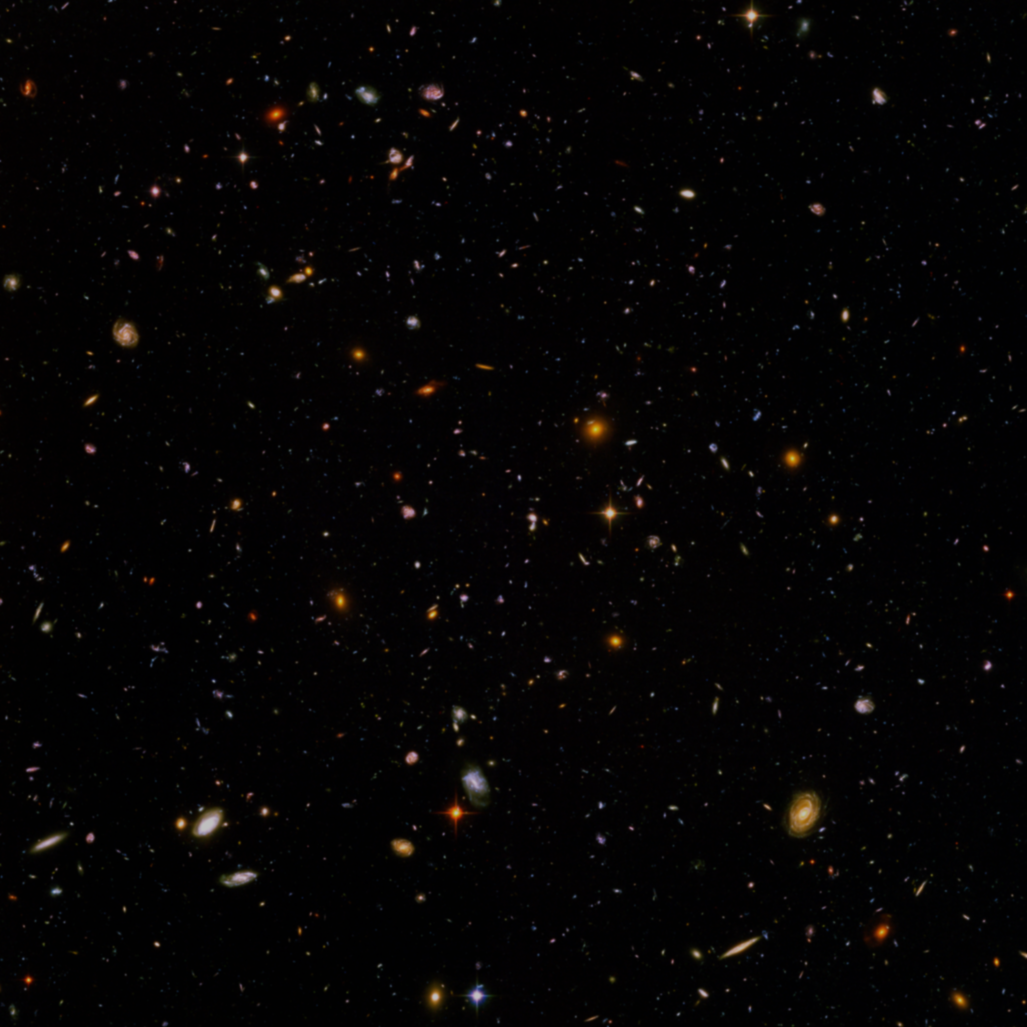
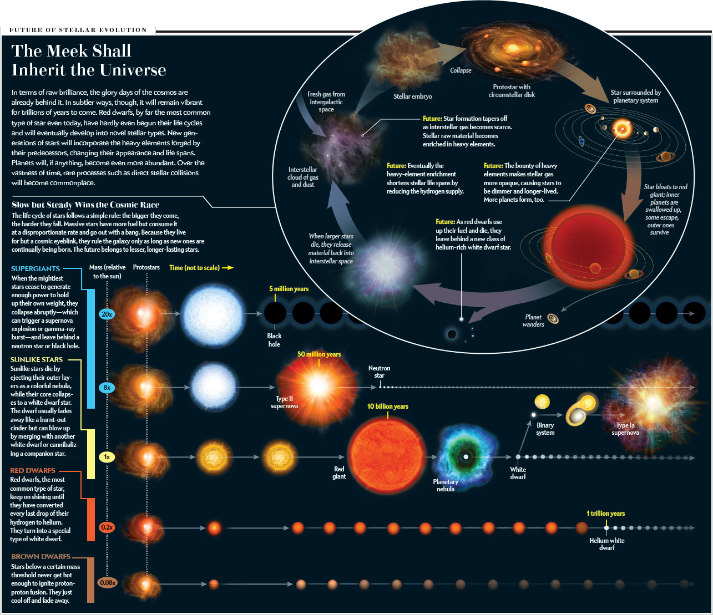
What We Attempted to Model
Stars are extremely complex and variable systems. The starting mass of a star has an enormous effect on what happens in that star’s life, how long it lives, and how it dies and what it’s final state is. Everything that happens in a single, isolated stellar lifetime can be predicted from the starting mass of the star in question. We sought to create a visual representation of a stellar life in Mathematica, based on just a single input mass.

Slide 4
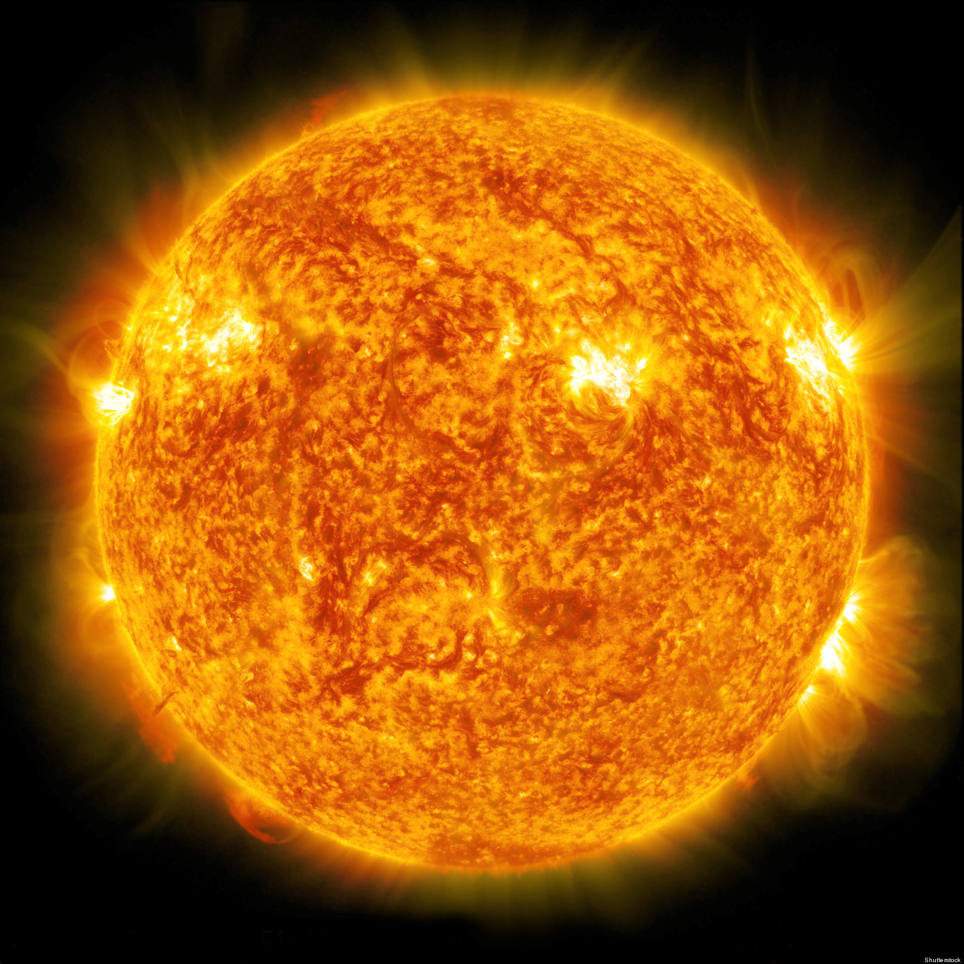
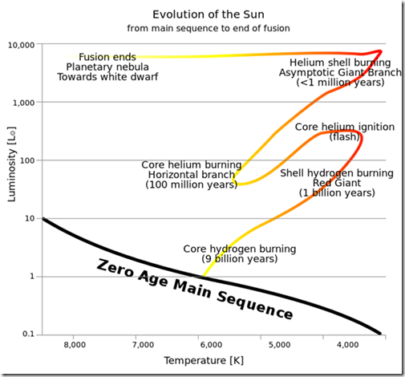
Life of a Sun Sized Star

Slide 5
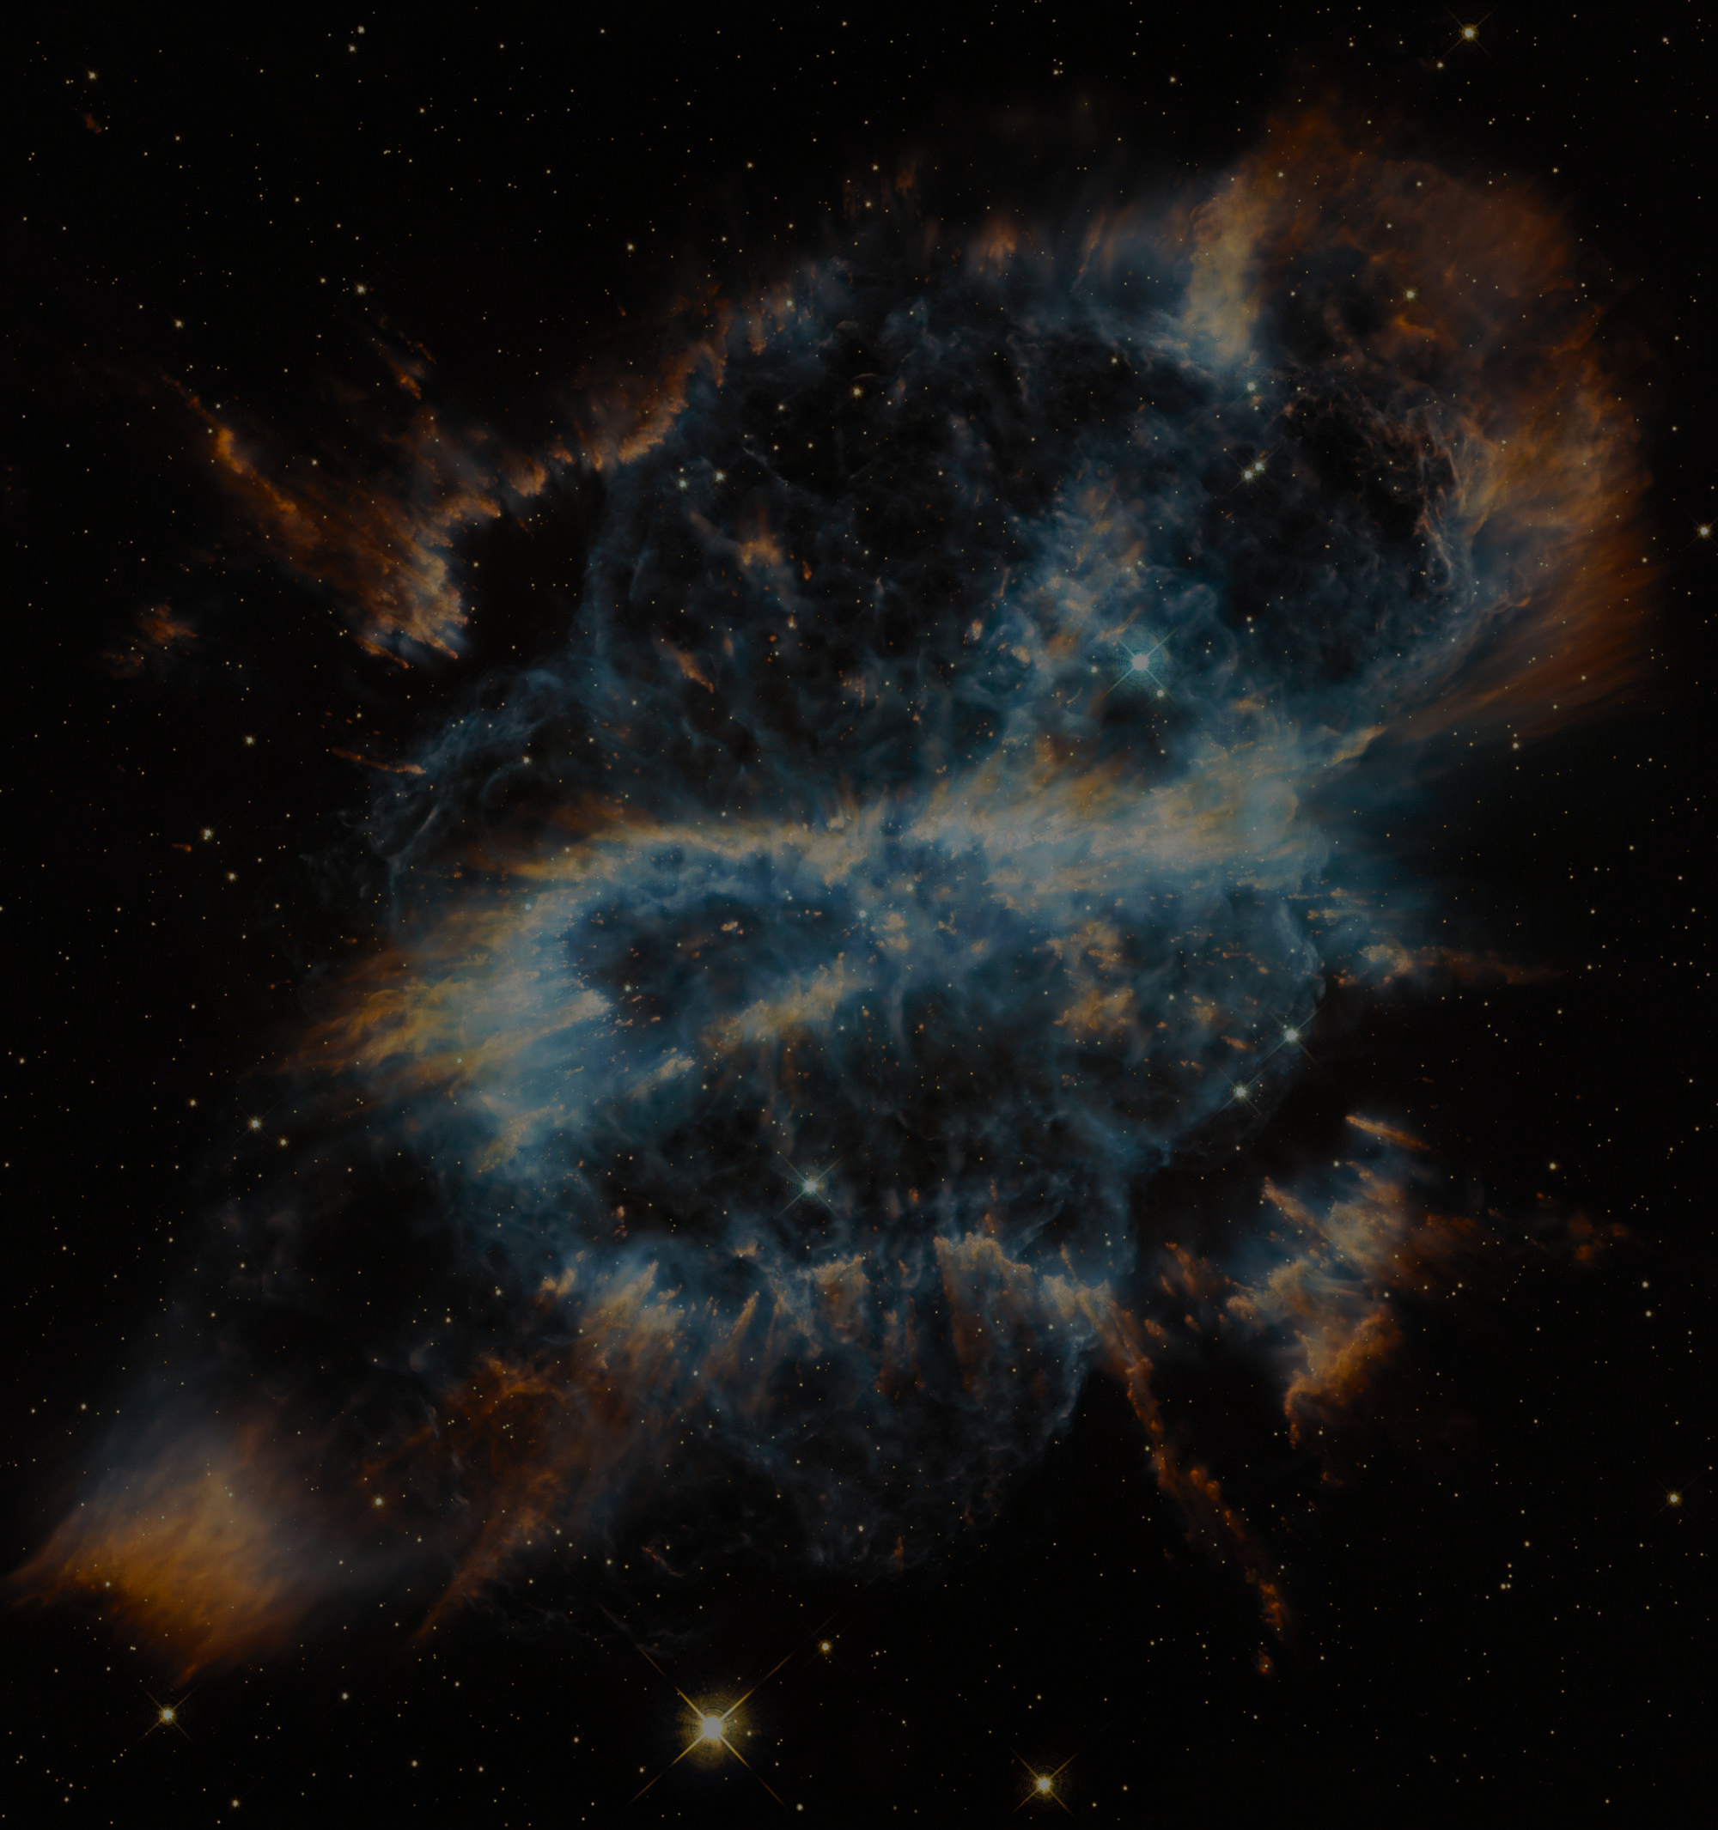
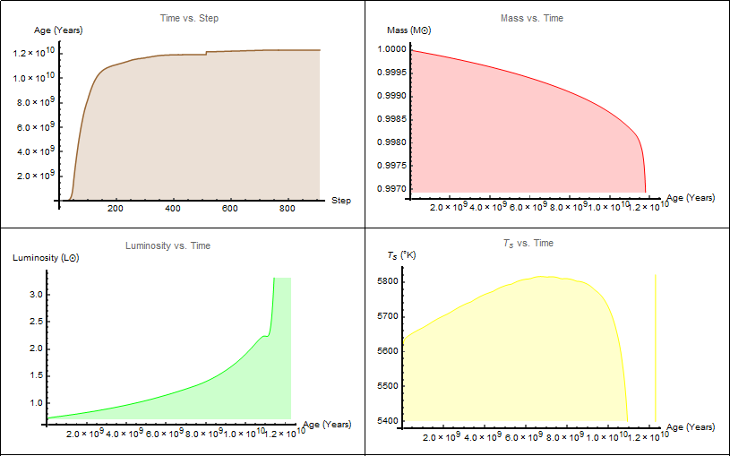
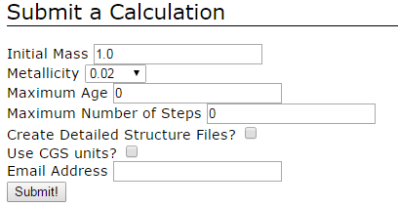
How We Did It/EZ-Web
The mathematics behind stellar evolution consists of a system of four partial differential equations that can only be solved numerically. One such equation expressed radius (an independent variable) as a function of time! Whatever work has already been done with these models has found that they can be numerically unstable and potentially unrealistic.
On the advice of our amazing mentor Dr. Carini, we took a database approach instead of programming in the actual math. This was a good choice, as it allowed us to focus more on other aspects of our code, such as the UI, error cases, and new and interesting graphical ideas.
The program we used to populate our database is called “EZ-Web.” It’s a stellar evolution code that takes input parameters and generates a series of text files detailing characteristics of the star at certain points in time.
We use those text files to construct a database, and pull necessary data from that database each time our program is executed. We then use Mathematica’s built in commands to create interpolated functions, and use those functions in our visual.

Slide 6
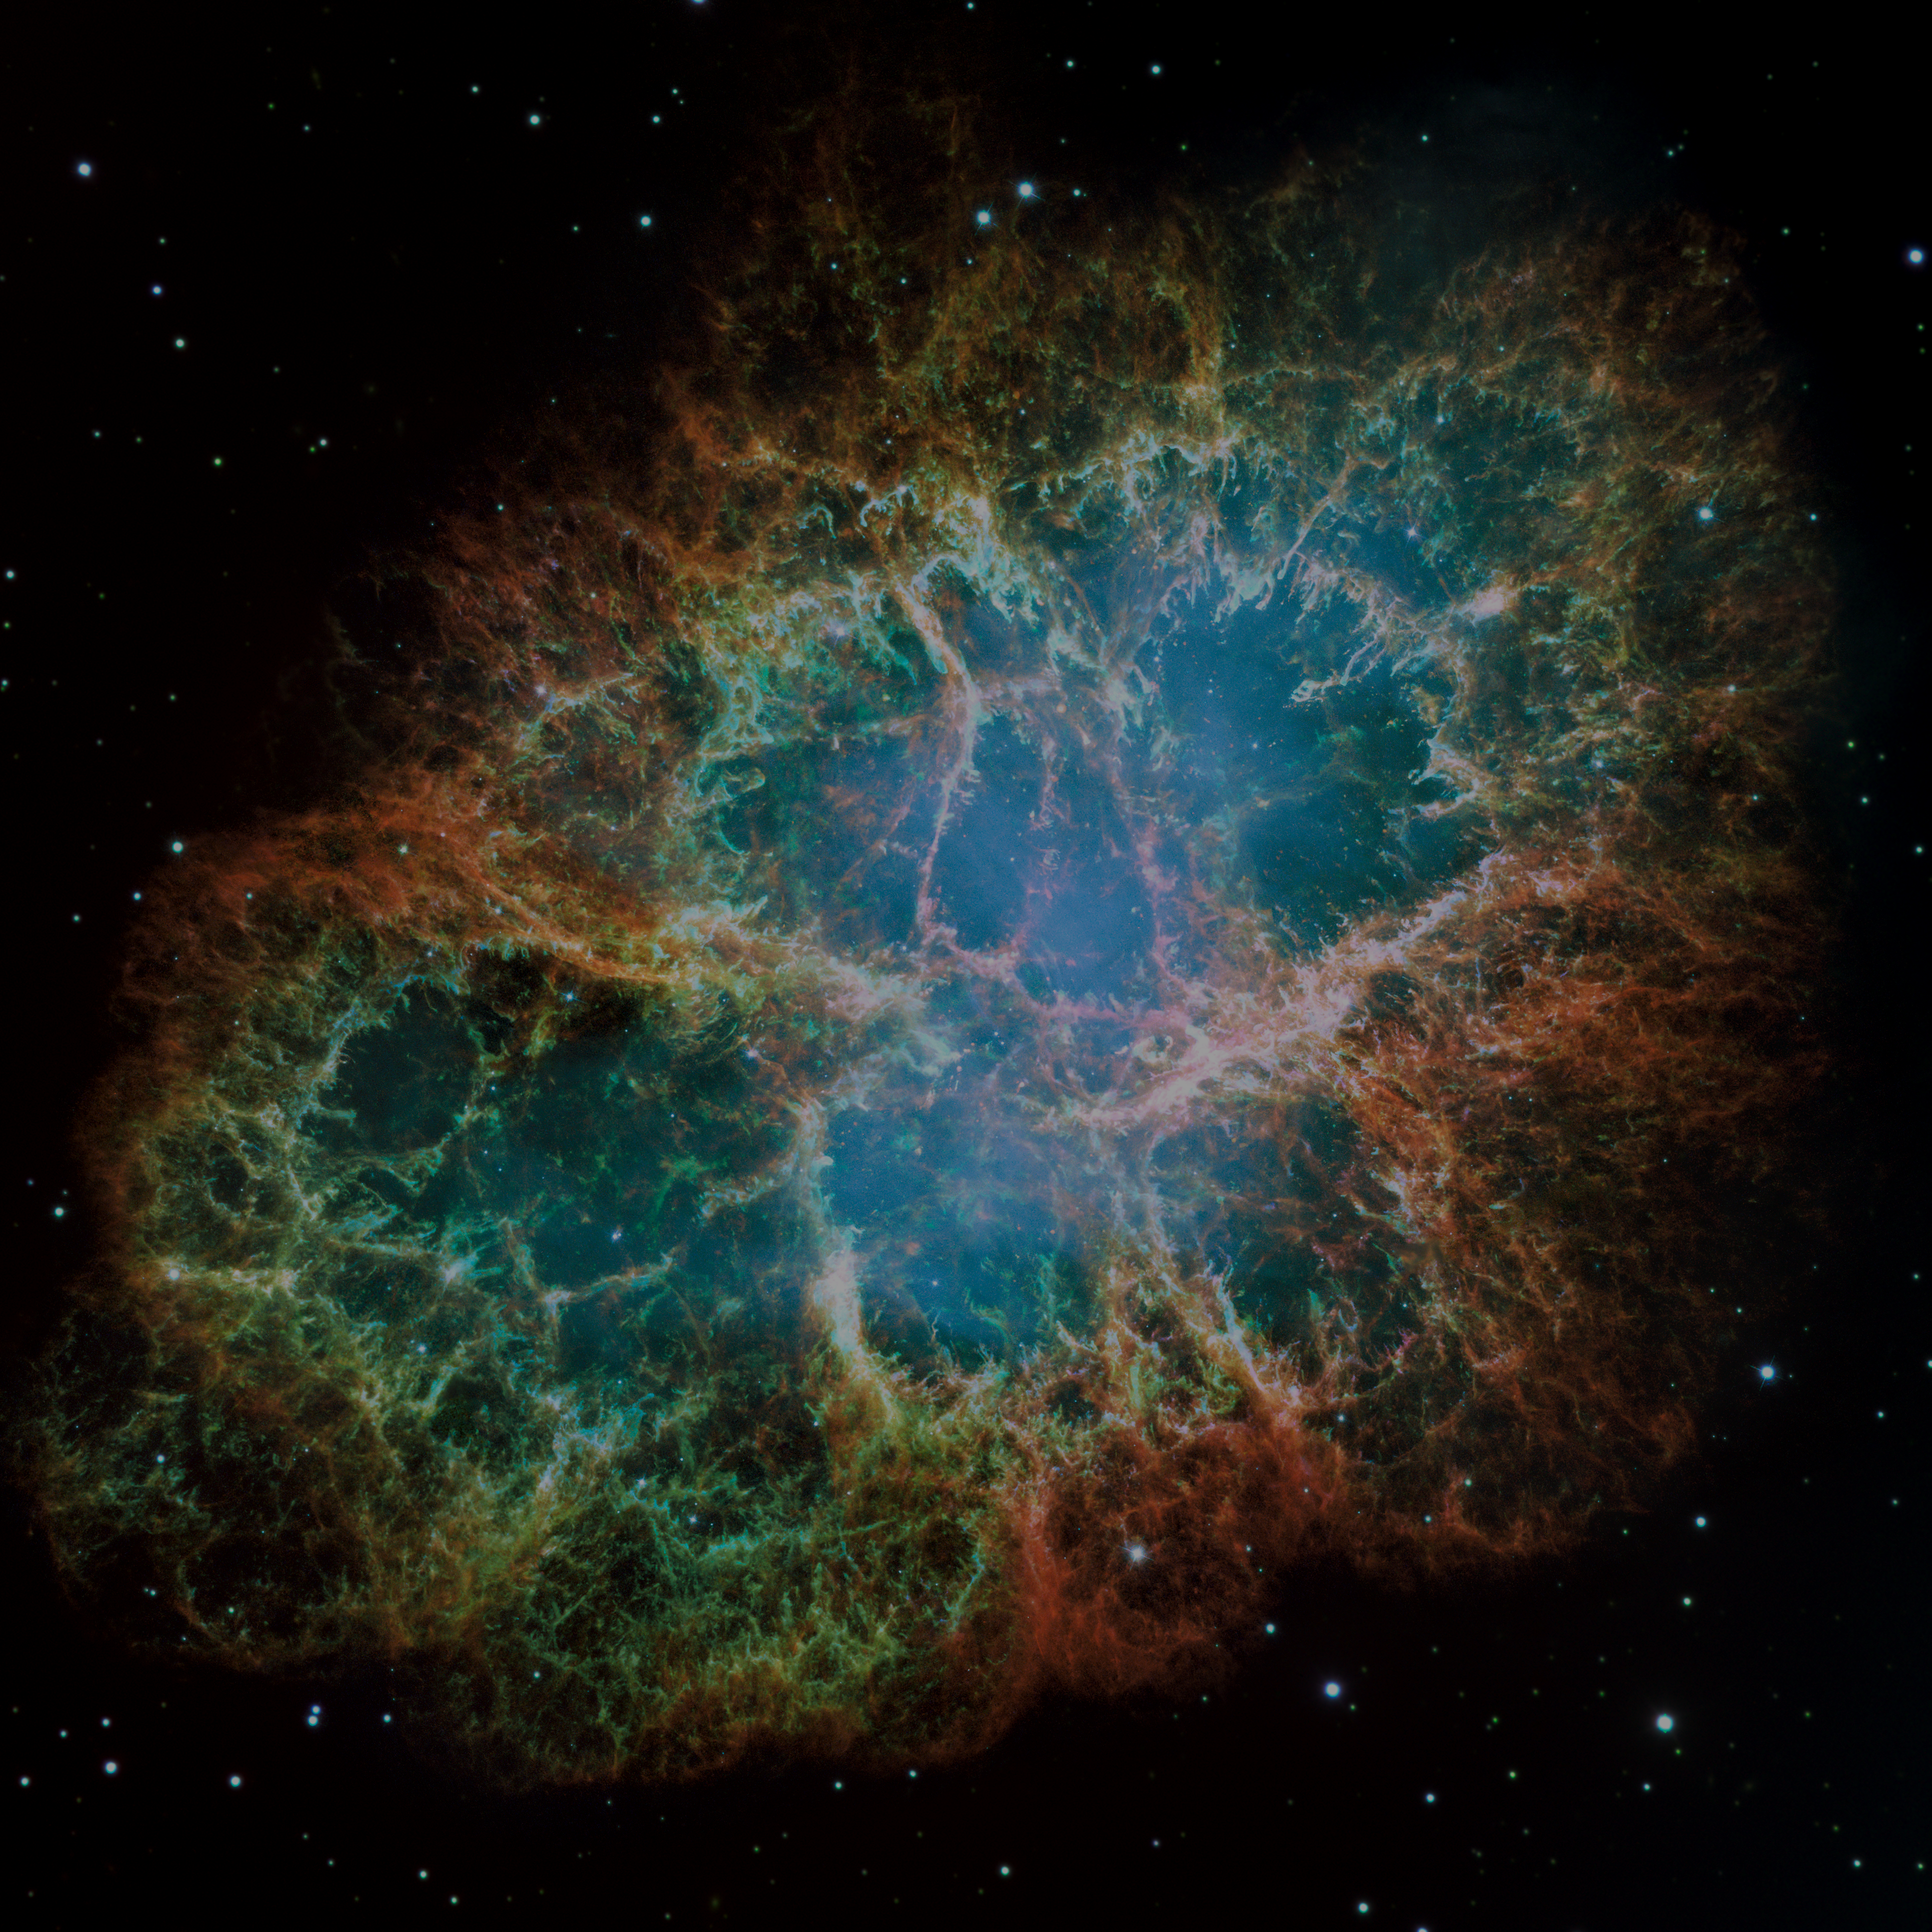
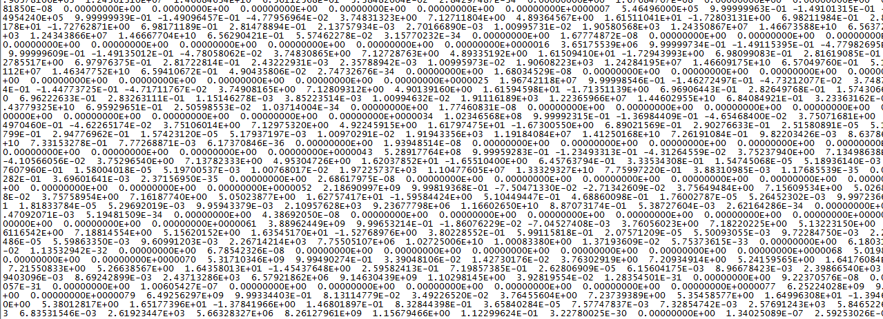
Database Limitations
EZ-Web is limited in the scope of stellar life that it provides. For stars smaller than our sun, the program gives data all the way from ZAMS stage to helium white dwarf. For a Sun-sized star, it provides star data up to and through the Planetary Nebula stage, but not white dwarf stage. For higher mass stars, the program only runs to the end of the CNO cycle and the start of helium fusion. Basically what that all means is that the more mass the star in question has, the less data on it EZ-Web provides. Since fabricating data is frowned upon, our code only runs through these times.

Slide 7
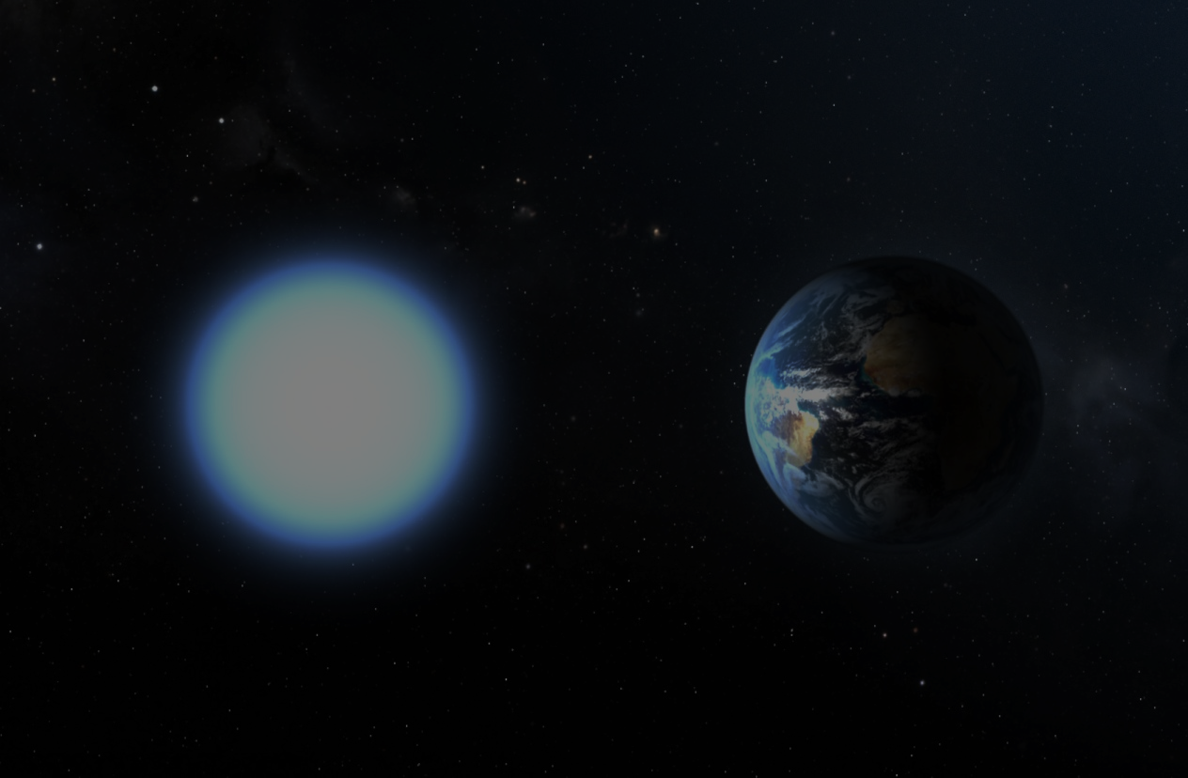
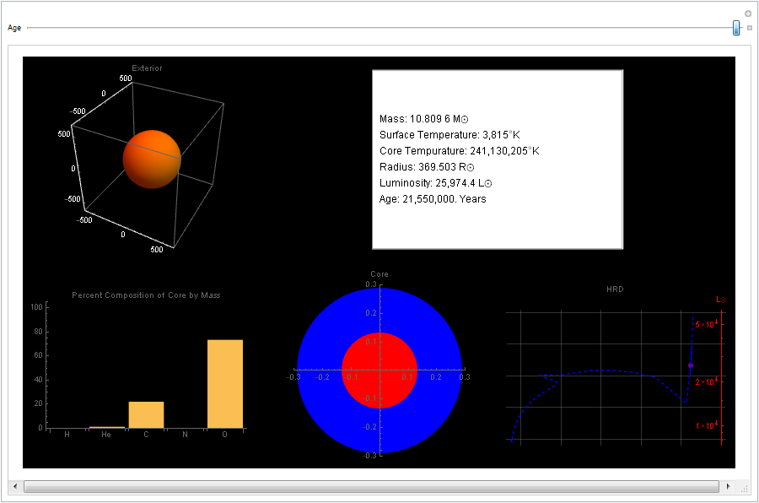
The Interface
Our interface consists of an exterior 3D star visual, a panel of text readouts, a bar graph showing core composition, a diagram of the interior, and a Hertzsprung-Russel Diagram with a point representing the star and a parametric plot representing the path the star will take on the diagram. We used Manipulate so that the visuals dynamically update in response to the Age slider on top.

Slide 8
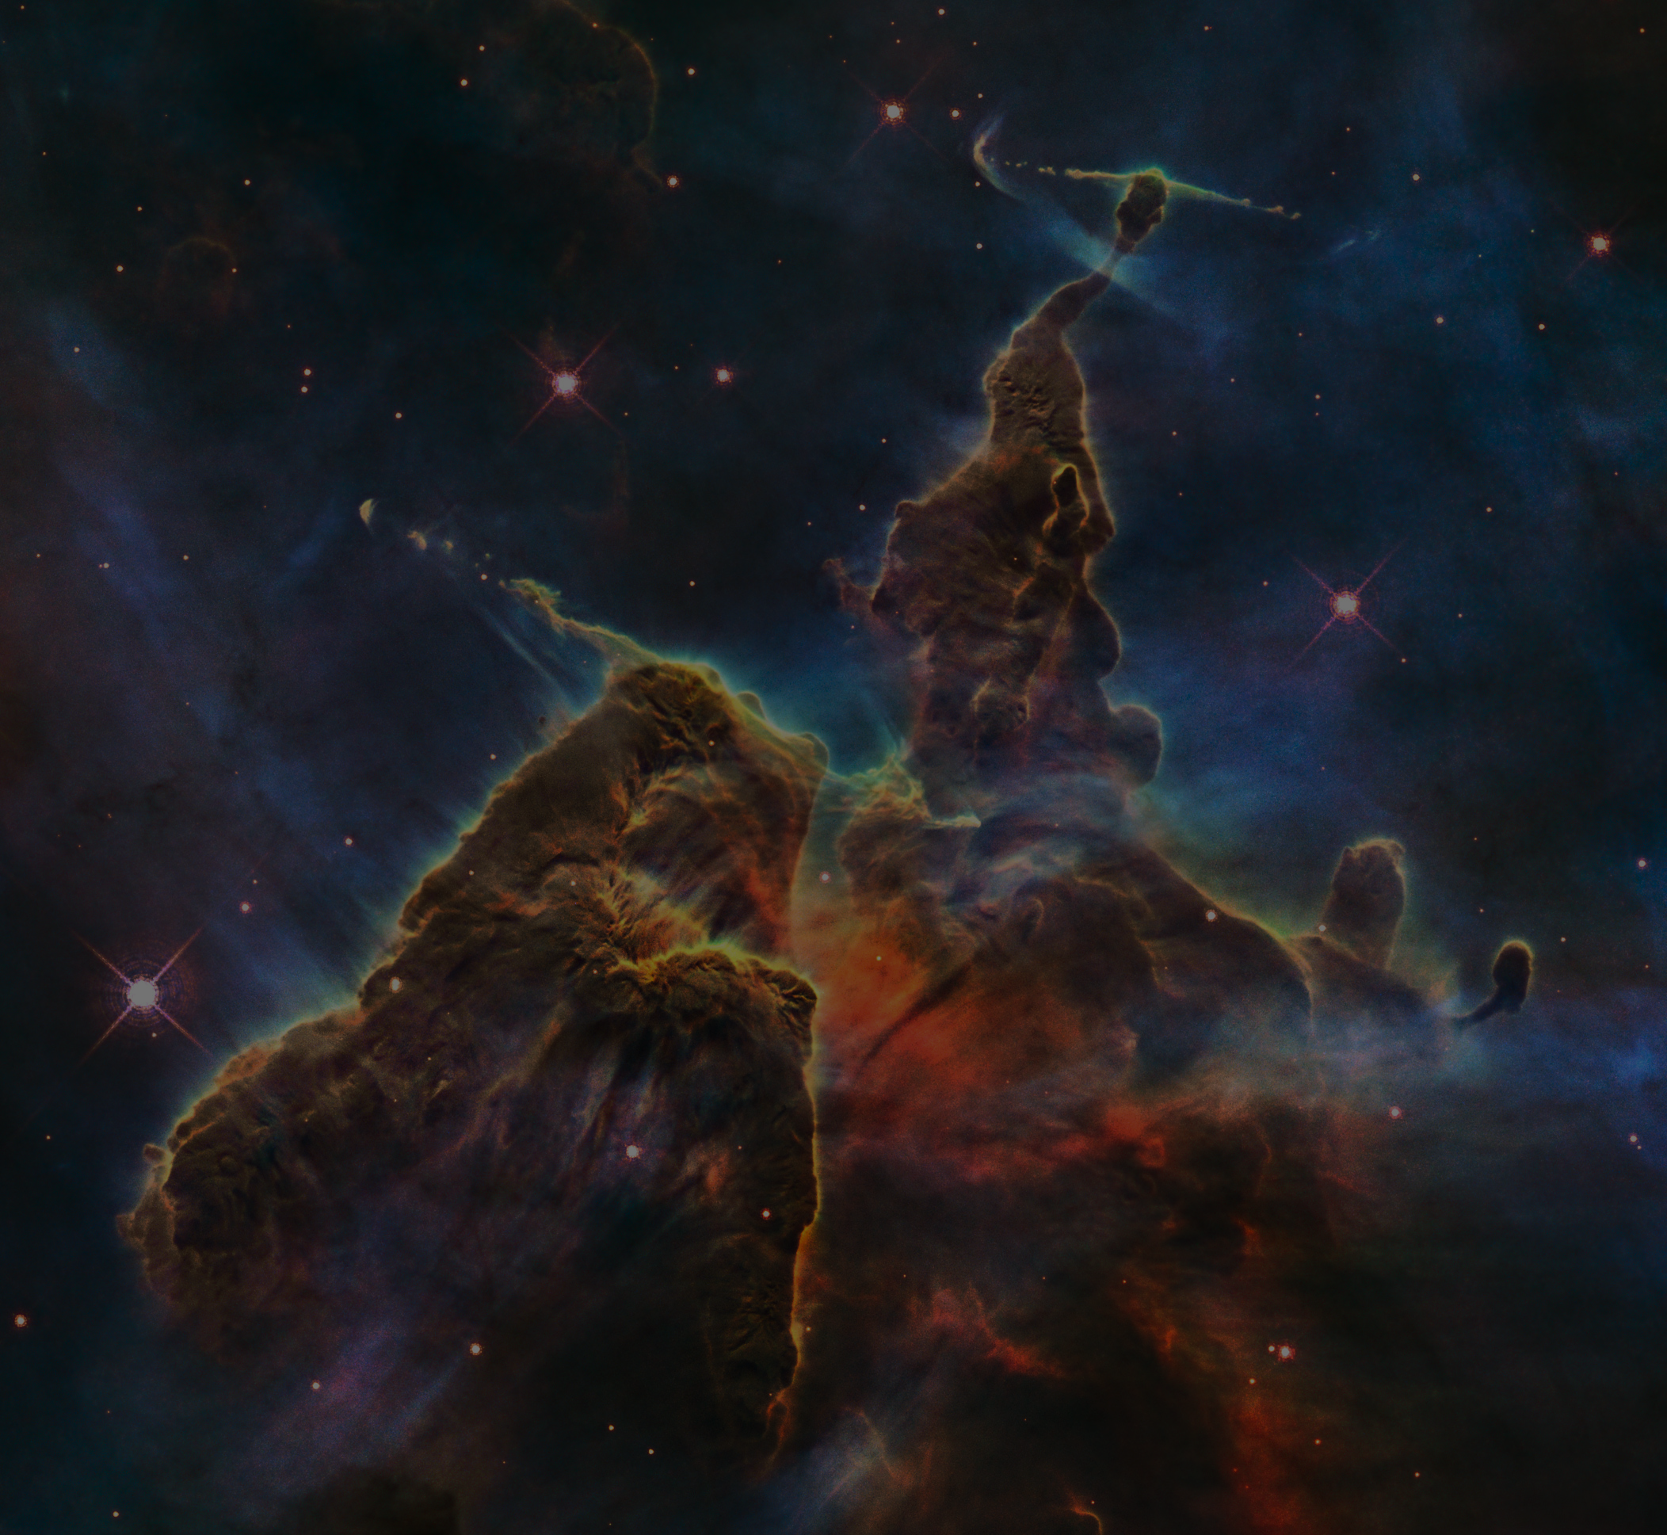
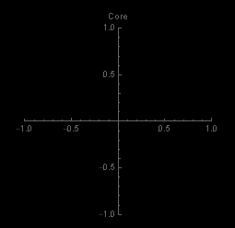
Core Function
When we demonstrate the code, you may be surprised to see that in the primary stages of a star’s life there isn’t anything in the “Core” graphic. This is because EZ-Web gives core radius values for helium, carbon, and oxygen only. At the start of a star’s life, there simply isn’t enough of those elements in a compact enough space to define a core, so the effective radius of the core is zero. We could create some kind of placeholder that puts a disk of what is assumed to be hydrogen in the graphic when there’s nothing else there, but that’s not very pertinent to our objective, so we haven’t done that yet.

Slide 9
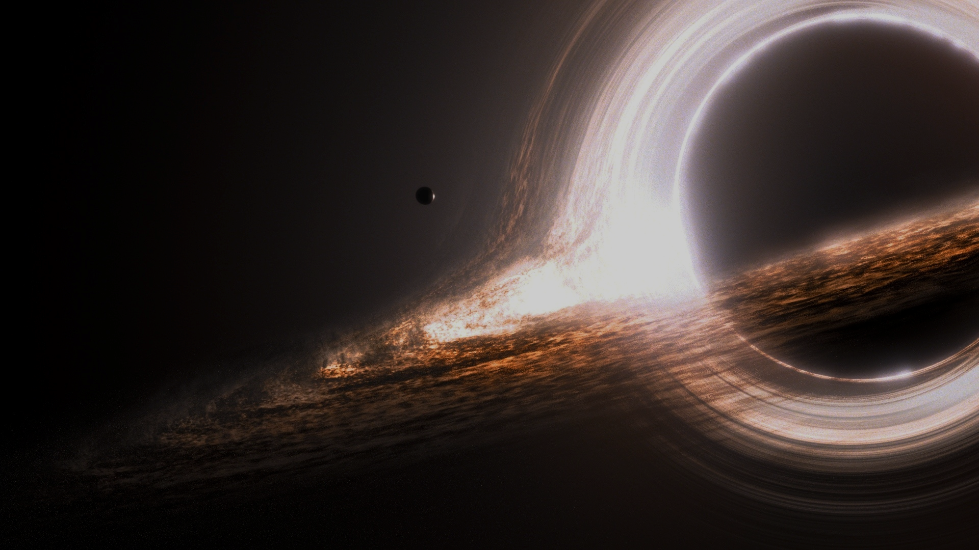
Evaluation Timeline
Command is evaluated (up to three arguments).
Error cases are tested, if an error in the input is detected, the code gives an error message and continues, using a default value.
Based on first argument, data for a certain mass star is pulled from our database and converted into lists and associations.
Individual data lists are converted into functions of age.
Functions are used in the interface to create a continuous timeline of the star’s life, from start point to end point (second and third arguments).

Slide 10
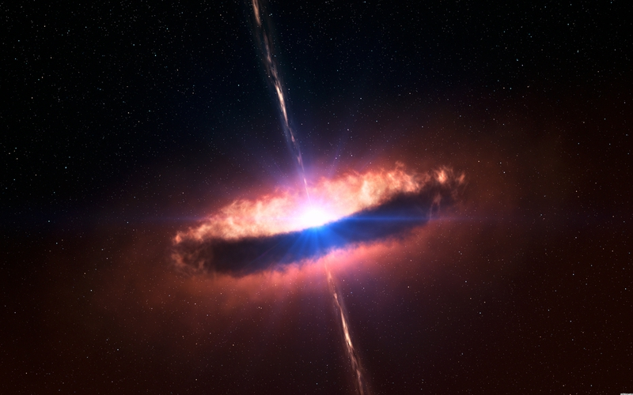
Thanks for watching!

Slide 11

Citations
Background Plates:
Black Hole
Crab Nebula
Hubble Ultra Deep Field
Mystic Mountain
Planetary Nebula
Red Supergiant
White Dwarf
Sun
Supernova
Stellar Diagrams:
http://www.nature.com/scientificamerican/journal/v306/n3/box/scientificamerican0312-32_BX2.html
https://rooksheathscience.com/2015/05/
EZ-Web:
http://www.astro.wisc.edu/~townsend/static.php?ref=ez-web#Using_EZ-Web
Information Sources:
http://www.universetoday.com/18847/life-of-the-sun/
https://astrosociety.org/edu/publications/tnl/39/sun2.html
Dr. Carini (the greatest physics mentor ever)

